Slide 1




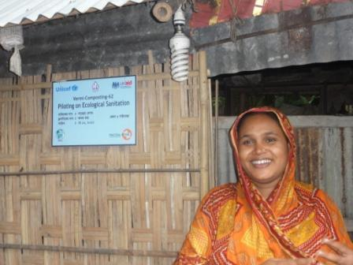
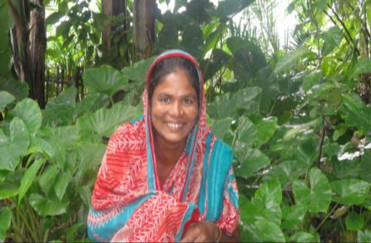

Welcome
SPACE presentation in the 7th World Toilet Leader’s Forum
SPACE
7th World Toilet Leader’s Forum Nov.25th – 26th 2020
SPACE

Slide 2

Contents
Introduction
History of the Projects
Current conditions of the Toilets
Operation Report
Major results Impacts
Major Challenges
Major learning
Conclusions
SPACE
7th World Toilet Leader’s Forum Nov. 25th -26th 2020
SPACE

Slide 3
Introduction to SPACE
SPACE
7th World Toilet Leader’s Forum Nov.25th – 26th 2020
SPACE

Slide 4
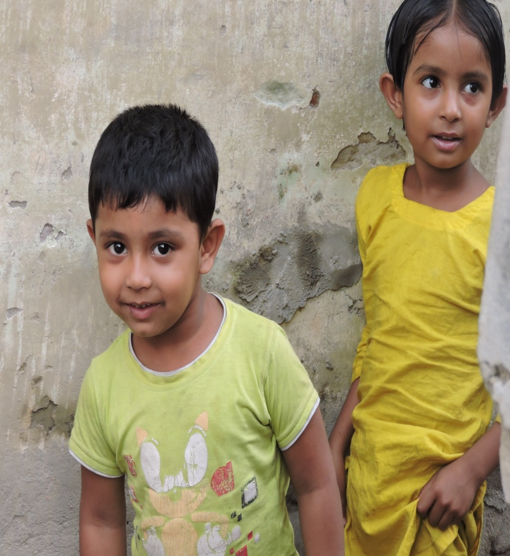
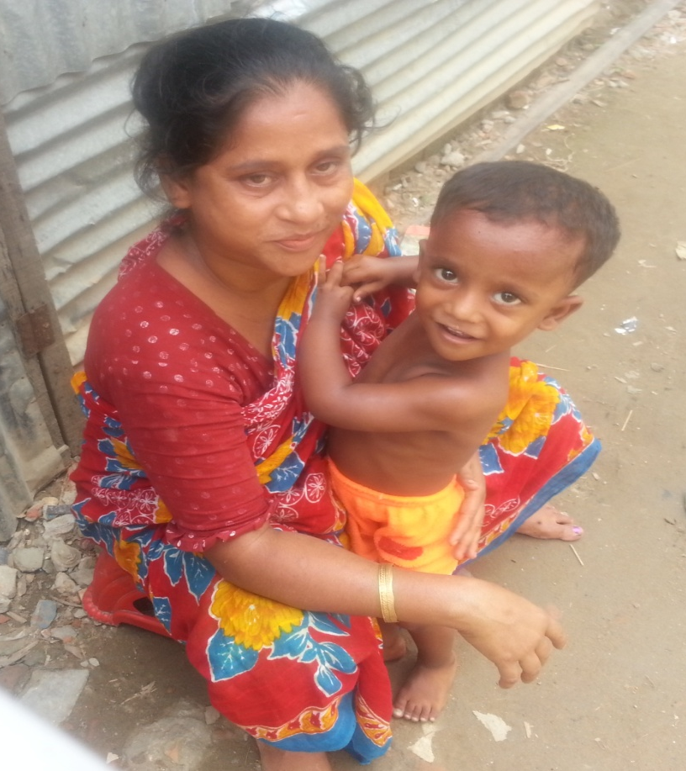

SPACE is a Child & Women Focused WASH NGO founded in 2003 which is holds legal status
SPACE
7th World Toilet Leader’s Forum Nov.25th – 26th 2020
SPACE

Slide 5
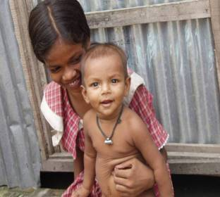
SPACE envisages a hunger-free country where all children lead a better life with improved health, resources, dignity and security
SPACE
7th World Toilet Leader’s Forum Nov.25th – 26th 2020
SPACE

Slide 6
History of the Project
SPACE
7th World Toilet Leader’s Forum Nov.25th – 26th 2020
SPACE

Slide 7
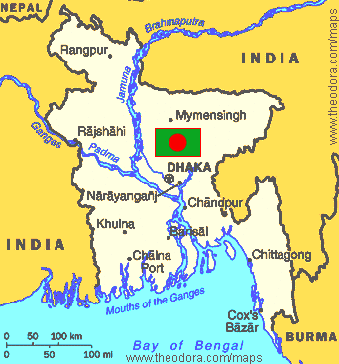
Bangladesh is one of the small countries in South Asia with an area of 147, 570 sq. Kms
Its population size is about 162.9 million according to the Human Development Report (2016).
Bangladesh is one of the most densely populated and stands the world's 8th most populous country.
Per capita income is US$ 1,314. But still 41% people less than 2 US$ in a day;
SPACE
SPACE

Slide 8
Project History-1
A recent survey reveals about 5.5 million urban poor workers are outdoors for 5 to 8 hours a day.
About 2-3 million people stay on streets for earning purpose and other necessities.
About 3 million people travel daily to Dhaka city from neighbouring areas and return by evening.
SPACE
7th World Toilet Leader’s Forum Nov.25th – 26th 2020
SPACE

Slide 9
Project History-2
To serve these people, there were only 65 public toilets, which are mostly unusable with irregular & improper O&M and management.
Those are not properly gender sensitive; therefore Women cannot safely use these toilets.
Inadequate accesses to public toilets lead people in open defecation that caused in environmental pollution & public health hazards.
SPACE
7th World Toilet Leader’s Forum Nov.25th – 26th 2020
SPACE

Slide 10
Project History-3
It is estimated that there is a need to construct over 1000 public toilets in Dhaka City to meet increasing demands.
Sanitation situation in project sites were very poor, which are getting improved in consequence of constructing WTA funded Public Toilets.
SPACE
7th World Toilet Leader’s Forum Nov.25th – 26th 2020
SPACE

Slide 11
Project History-3
It is estimated that there is a need to construct over 1000 public toilets in Dhaka City to meet increasing demands.
Sanitation situation in project sites were very poor, which are getting improved in consequence of constructing WTA funded Public Toilets.
SPACE
7th World Toilet Leader’s Forum Nov.25th – 26th 2020
SPACE

Slide 12
Project History- 4
In purpose to contribute in improving sanitation situations SPACE in partnership with DNCC constructed 3 public toilets in Dhaka City.
Sanitation situation in project sites were very poor, which are getting improved in consequence of constructing WTA funded Public Toilets.
SPACE
7th World Toilet Leader’s Forum
SPACE

Slide 13
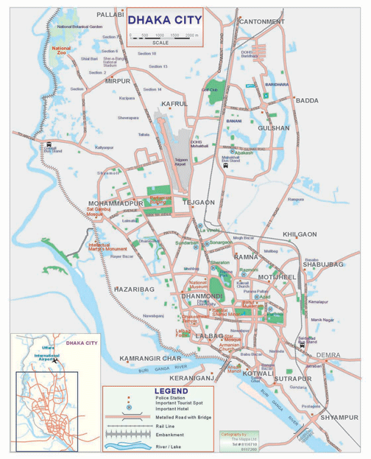
Location of WTA-SPACE Toilets
SPACE
7th World Toilet Leader’s Forum Nov.25th – 26th 2020
SPACE

Slide 14
Current Conditions of Toilets
SPACE
7th World Toilet Leader’s Forum
SPACE

Slide 15
Public Toilets under all the three projects are running & covering less users in consequences of Covid-19.
Management, O&M are as usual as these were before.
Private Operator’s maintained two Toilets are found always neat, clean & odor less; but one toilet under small project managed by community sometimes found dirty with bit odors.
SPACE
7th World Toilet Leader’s Forum
SPACE

Slide 16
Operation Report
SPACE
7th World Toilet Leader’s Forum Nov.25th – 26th 2020
SPACE

Slide 17
Management, O&M
Two Toilets under 1st & 3rd projects are managed by the Private Operators while one Toilets under 2nd project is managed by users community.
Toilet Management Committee consisting of 7 members from DNCC, Local Elected, Local Leaders & SPACE rep. watch the toilets.
Users pay tariff for each use amounting Tk. 5 for urination & defecation while Tk. 10 for showering;
The community pays a monthly fixed amount Tk. 200 each households.
SPACE
7th World Toilet Leader’s Forum Nov.25th – 26th 2020
SPACE

Slide 18
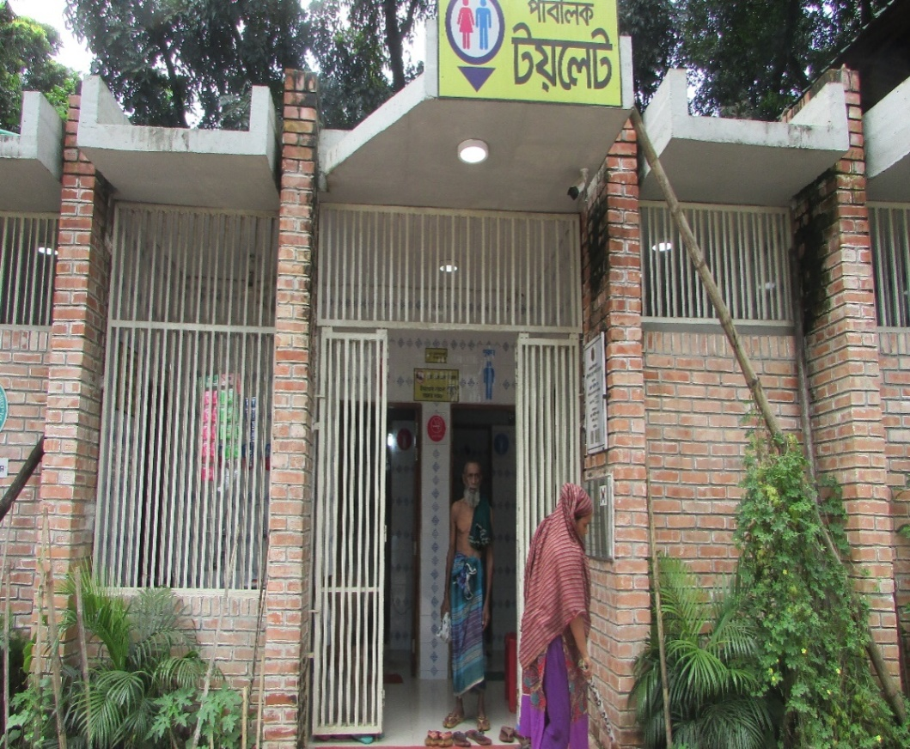
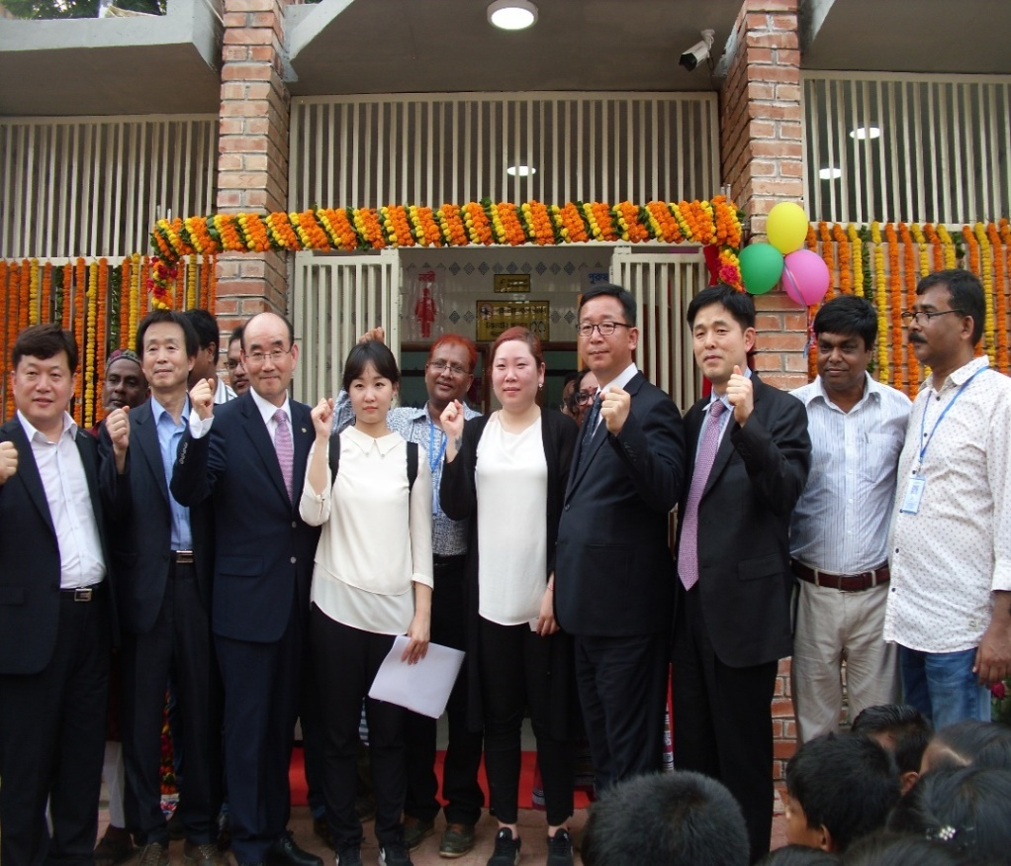
Toilet-1
7th World Toilet Leader’s Forum Nov.25th – 26th 2020
SPACE
SPACE

Slide 19
Facilities & tariffs
This toilet consists of ten compartments 3 rooms for women, 1 room for people with disabilities; 3 rooms for men, one store room, 2 shower rooms for women & men; 2 group hand washing units for all; 3 urinals for men; MHM facilities in women’s chamber;
Access to separate hand washing facilities for women & men
Improved access to safe drinking water is available
CCTV camera is attached for security purposes;
Users pay Tk. 10 for showering & defecation, Tk. 5 for urination & Tk. 2 for drinking water per glass.
SPACE
7th World Toilet Leader’s Forum Nov.25th – 26th 2020
SPACE

Slide 20
Project-1
Upon construction in April 2017, this Toilet has been being operated excellently;
So far, the 1st project served over 550,000 people out of which 20% are women and serves 465 people daily on an average.
It is operating at present; but number of users dramatically reduced due to Covid-19 and number of daily users are 284
SPACE
7th World Toilet Leader’s Forum Nov.25th – 26th 2020
SPACE

Slide 21
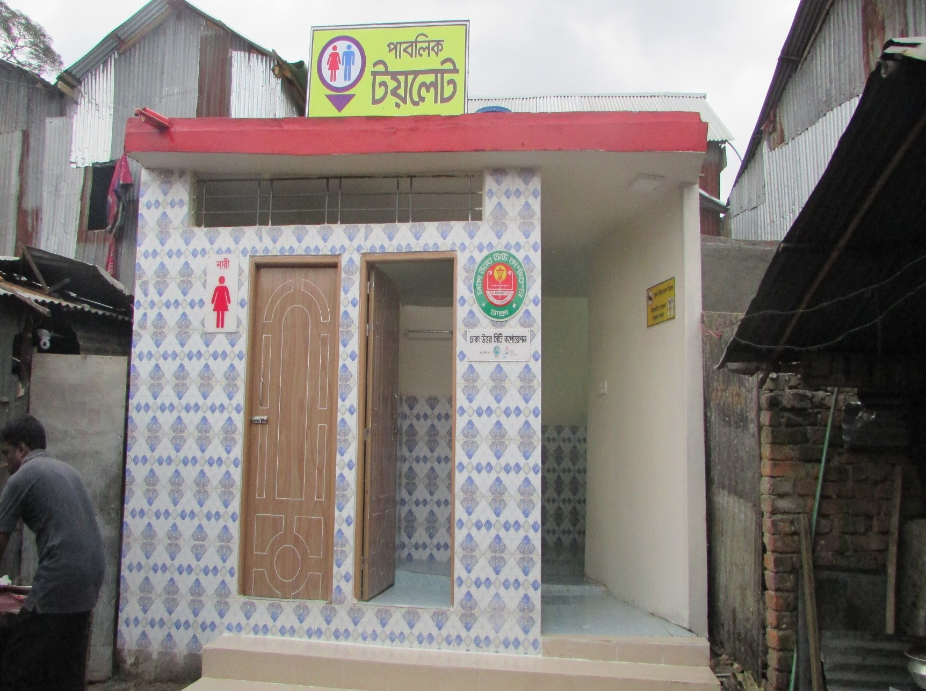
Toilet-2

Slide 22
Facilities & tariffs
This toilet consists of four compartments 2 rooms for women, 2 rooms for men, 1 shower rooms for women & men; 2 urinals for men; MHM facilities in women’s chamber;
Access to separate hand washing facilities for women & men
Users pay monthly tariff amount Tk. 200 per household.
SPACE
7th World Toilet Leader’s Forum Nov.25th – 26th 2020
SPACE

Slide 23
Project-2
Upon construction in July 2018, this Toilet has been being operated well; but not satisfactorily;
So far, the 2nd project served 277 people from 56 households and about 70 people from a market, out of which, 30% are women and serves 465 people daily on an average.
It is operating at present; but number of users decreased due to Covid-19 and number of daily users are less than 200.
SPACE
7th World Toilet Leader’s Forum Nov.25th – 26th 2020
SPACE

Slide 24
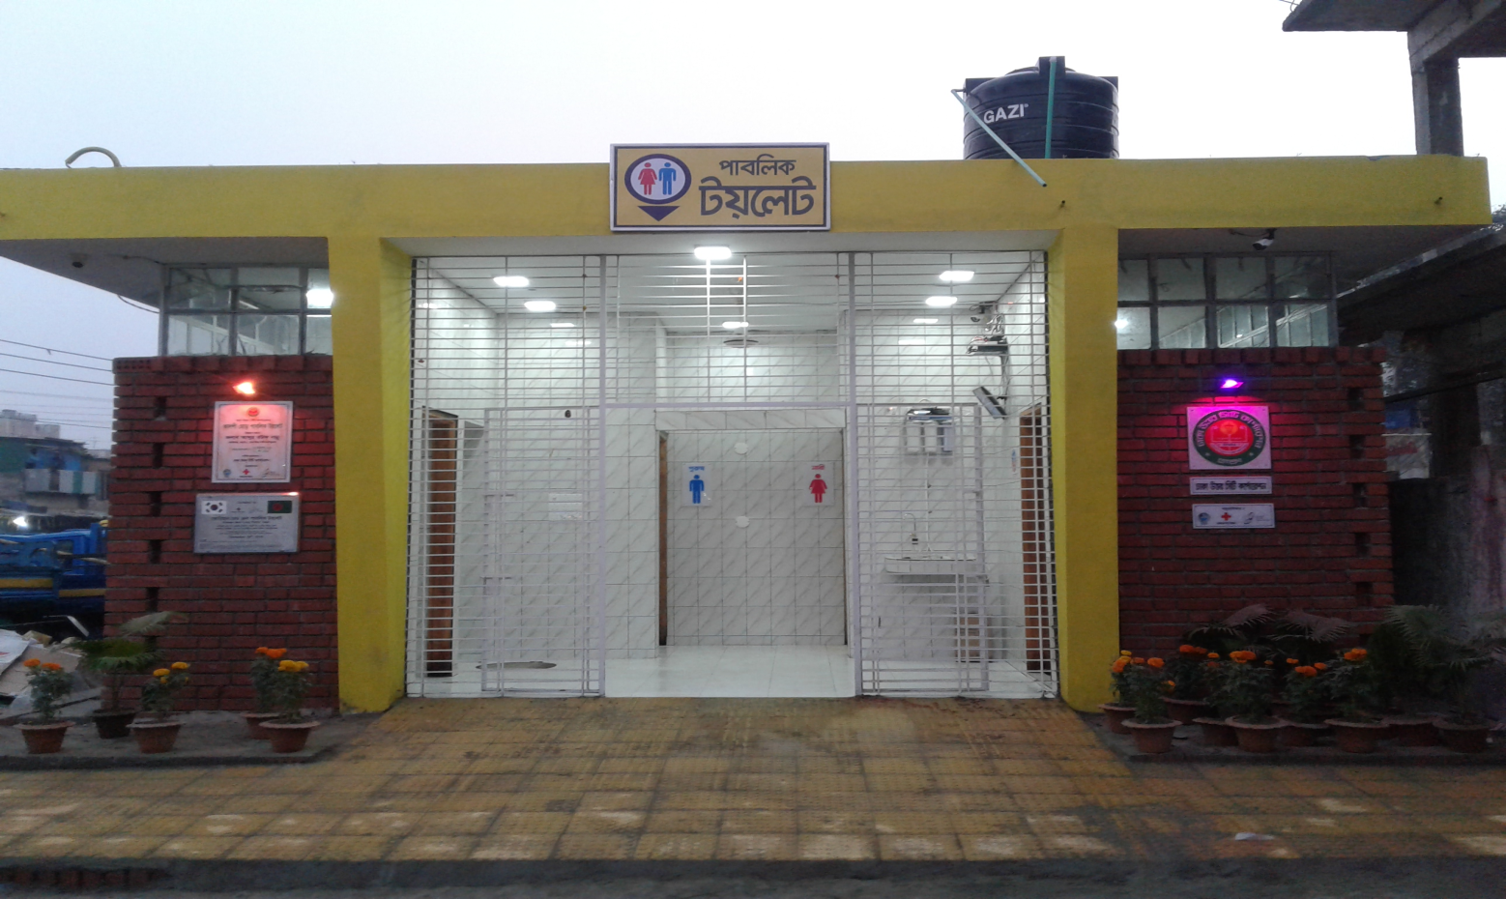
Toilet No.3
SPACE
7th World Toilet Leader’s Forum Nov.25th – 26th 2020
SPACE

Slide 25
Facilities & tariffs
This toilet consists of fourteen compartments 4 rooms for women, 4 rooms for men, one room for people with disabilities; 1 breast feeding room; 1 store room, 2 shower rooms for women & men; 2 group hand washing units for all; 3 urinals for men; MHM facilities in women’s chamber;
Access to separate hand washing facilities for women & men
Improved access to safe drinking water is available
CCTV camera is attached for security purposes;
Users pay Tk. 10 for showering & defecation, Tk. 5 for urination & Tk. 2 for drinking water per glass.
SPACE
7th World Toilet Leader’s Forum Nov.25th – 26th 2020
SPACE

Slide 26
Project-3
Upon construction in December 2019, it has started functioning from March 2020.
Right after staring functions, it is affected by the effects of Covid-19. therefore, numbers of users are not very usual.
So far, it has served 215 users daily on an average and total approximate 51000.
SPACE
7th World Toilet Leader’s Forum Nov.25th – 26th 2020
SPACE

Slide 27
Users & cost management
General people, travelers, Rickshaw-van pullers, drivers, Bus passengers, local shopkeepers, local slum dwellers, students of private university, college & schools are the major users of this toilet.
Private operator manages the toilets who has appointed 4 cleaners (2 women & 2 men);
Wages of cleaners, cleaning materials along with water supply & electricity costs are managed from the daily collected tariffs given by the users;
SPACE
7th World Toilet Leader’s Forum Nov.25th – 26th 2020
SPACE

Slide 28
Major learning
Public Toilets function well if it is operated by the Competent Private Operators under the close & coordinated supervision of municipal authorities & NGOs.
Public toilets whether big or small do not work well if constructed private lands. Public toilets should be constructed at public lands.
SPACE
7th World Toilet Leader’s Forum Nov.25th – 26th 2020
SPACE

Slide 29
Acknowledgements
WTA & Suwon City Corporation
Korean Red Cross Society
Dhaka North City Corporation
Local Elected Body
Whom directly & indirectly contributed
The Government of Bangladesh & South Korea
SPACE
7th World Toilet Leader’s Forum Nov.25th – 26th 2020
SPACE

Slide 30
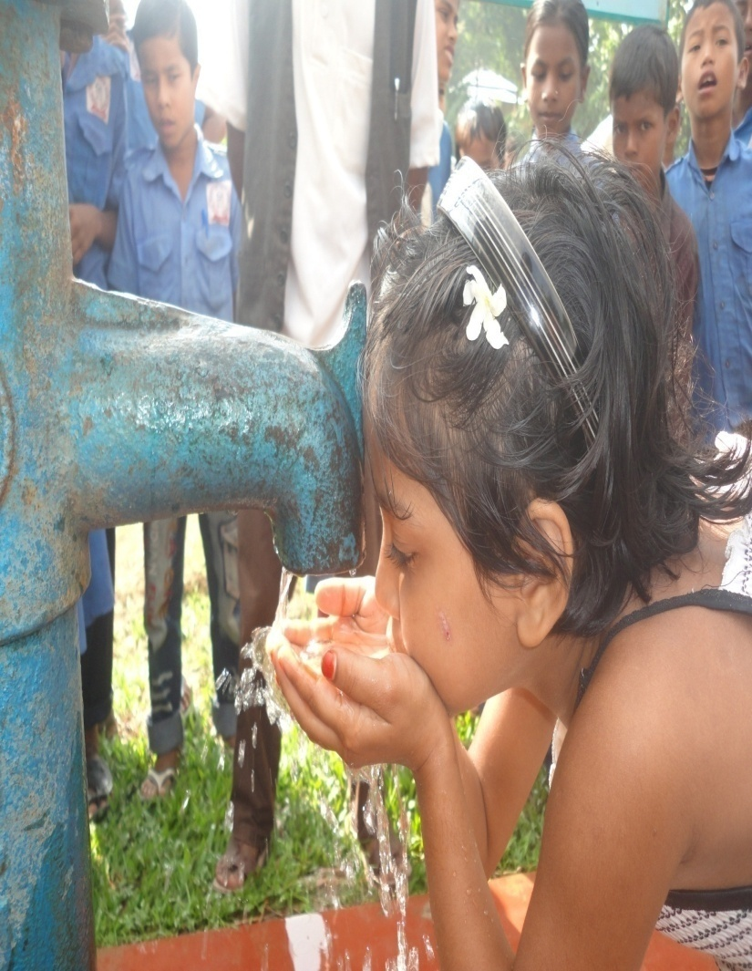
Thank You

